Slide 1
Overview of Exception Handling
Definition:
Exceptions (PL/SQL runtime errors) can arise from design faults, coding mistakes, hardware failures, and many other sources.
You cannot anticipate all possible exceptions, but you can write exception handlers that let your program to continue
Syntax:
EXCEPTION
WHEN ex_name_1 THEN statements_1 -- Exception handler
WHEN ex_name_2 OR ex_name_3 THEN statements_2 -- Exception handler
WHEN OTHERS THEN statements_3 -- Exception handler
END;

Slide 2
Exception Categories
1. Internally defined
The runtime system raises internally defined exceptions implicitly (automatically). Examples of internally defined exceptions are ORA-00060 (deadlock detected while waiting for resource) and ORA-27102 (out of memory).
An internally defined exception always has an error code, but does not have a name unless PL/SQL gives it one or you give it one.
2. Predefined
A predefined exception is an internally defined exception that PL/SQL has given a name. For example, ORA-06500 (PL/SQL: storage error) has the predefined name STORAGE_ERROR.
3. User-defined
You can declare your own exceptions in the declarative part of any PL/SQL anonymous block, subprogram, or package. For example, you might declare an exception named insufficient_funds to flag overdrawn bank accounts.

Slide 3
Exception Categories
Category | Definer | Has Error Code | Has Name | Raised Implicitly | Raised Explicitly
Internally defined | Runtime system | Always | Only if you assign one | Yes | Optionally
Predefined | Runtime system | Always | Always | Yes | Optionally
User-defined | User | Only if you assign one | Always | No | Always

Slide 4
Predefined Exception
DECLARE
stock_price NUMBER := 9.73;
net_earnings NUMBER := 0;
pe_ratio NUMBER;
BEGIN
pe_ratio := stock_price / net_earnings; -- raises ZERO_DIVIDE exception
DBMS_OUTPUT.PUT_LINE('Price/earnings ratio = ' || pe_ratio);
EXCEPTION
WHEN ZERO_DIVIDE THEN
DBMS_OUTPUT.PUT_LINE('Company had zero earnings.');
pe_ratio := NULL;
END;
/

Slide 5
Predefined Exception
Exception Name | Error Code
ACCESS_INTO_NULL | -6530
CASE_NOT_FOUND | -6592
COLLECTION_IS_NULL | -6531
CURSOR_ALREADY_OPEN | -6511
DUP_VAL_ON_INDEX | -1
INVALID_CURSOR | -1001
INVALID_NUMBER | -1722
LOGIN_DENIED | -1017
NO_DATA_FOUND | +100
NO_DATA_NEEDED | -6548
NOT_LOGGED_ON | -1012
PROGRAM_ERROR | -6501
ROWTYPE_MISMATCH | -6504
SELF_IS_NULL | -30625
STORAGE_ERROR | -6500
SUBSCRIPT_BEYOND_COUNT | -6533
SUBSCRIPT_OUTSIDE_LIMIT | -6532
SYS_INVALID_ROWID | -1410
TIMEOUT_ON_RESOURCE | -51
TOO_MANY_ROWS | -1422
VALUE_ERROR | -6502
ZERO_DIVIDE | -1476

Slide 6
User defined Exception
Three Steps
1. Declare Exception in DECLARATIVE Part
Syntax : <exception_name> EXCEPTION;
Example: high_salary EXCEPTION;
2. Raise the Exception when required in EXECUTABLE Part
Syntax : RAISE <exception_name>;
Example: RAISE high_salary;
3. Handle the Exception in EXCEPTION Part
Syntax : WHEN <exception_name> THEN <statement>
Example: WHEN high_salary THEN
rollback;

Slide 7
User defined Exception - Example
DECLARE
salary_too_high EXCEPTION;
current_salary NUMBER := 20000;
max_salary NUMBER := 10000;
BEGIN
IF current_salary > max_salary THEN
RAISE salary_too_high; -- raise exception
END IF;
EXCEPTION
WHEN salary_too_high THEN -- start handling exception
DBMS_OUTPUT.PUT_LINE ('Maximum salary is ' || max_salary || '.');
END;
/

Slide 8
RAISE_APPLICATION_ERROR Procedure
you invoke this procedure to raise a user-defined exception and return its error code and error message to the invoker.
Syntax:
RAISE_APPLICATION_ERROR (error_code, message);
You must have assigned error_code to the user-defined exception with the EXCEPTION_INIT pragma.
Syntax:
PRAGMA EXCEPTION_INIT (exception_name, error_code)

Slide 9
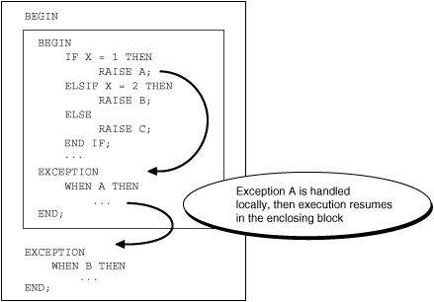
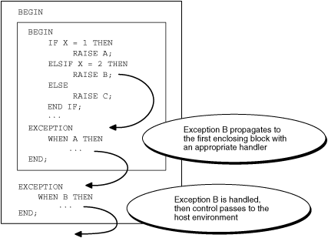
Figure 11-2 Exception Propagates from Inner Block to Outer Block
EXCEPTION PROPAGATION

Slide 10
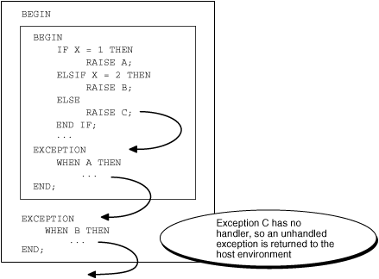
Figure 11-2 Exception Propagates from Inner Block to Outer Block
L/SQL Returns Unhandled Exception Error to Host Environment
EXCEPTION PROPAGATION…cont

